Slide 1

The Next-Gen Crowdfunding Dapp using Blockchain (PSID-1589)
1. Patil Manasi Ramkrushna (TYAIML-19)
2. Bari Vaibhav Ramchandra (TYAIML-43)
3. Patil Sakshi Rajendra (TYAIML-58)
4.Mali Nitisha Sharad(TYAIML-59)
Department of Articial Intelligence and Machine Learning
The Shirpur Education Society’s
R. C. Patel Institute of Technology, Shirpur - 425405.
[2024-25]

Slide 2
Problem Statement :
In today’s digital landscape, fraudulent campaigns, misinformation, and lack of transparency are major concerns in crowdfunding and decentralized governance systems. Traditional platforms struggle with authenticity verification, campaign classification, and user sentiment analysis, making them vulnerable to scams and manipulation.

Slide 3
Introduction
A practical problem statement emerges: How can organizations effectively transition from centralized crowdfunding platforms to de centralized blockchain solutions, ensuring transparency, security, and efficiency, while overcoming implementation hurdles and regulatory obstacles
Smart contracts enhance security, mitigating fraud risks, while bypassing intermediaries streamlines processes, reducing transaction costs and delays. Yet, transitioning to blockchain-powered crowdfunding presents challenges, such as integration complexities and regulatory uncertainties, hindering widespread adoption.

Slide 4
Objective
Leverage Blockchain for Transparency & Security
Ensure secure and immutable transaction records in crowdfunding.
Eliminate Centralized Authority
Enable decentralized tracking of fund usage and governance decisions.
Automate secure and efficient fund allocation, reducing risks of fraud.
Maintain tamper-proof financial records and improve trust in fund distribution.

Slide 5
Flowchart:
Fundraising & Donor Contributions
User Registration & Authentication:
Transparency & Project Updates
01
02
03
04
05
Campaign Creation & Smart Contract Deployment:
Fundraiser submits campaign details (project name,goal amount, deadline).
Fund Distribution and Verification

Slide 6
Technology Stack
Blockchain Infrastructure
Blockchain Network: Ethereum
Blockchain Interaction:
Web3.js / Ethers.js (Frontend)
Web3.py (Backend)

Slide 7
Backend :
Backend & API Development
Framework: Flask / FastAPI (Python) for API development.
Functionality:
Accepts user requests (fundraisers, donors, investors).
Interacts with the smart contract.
Manages transactions and campaign status.

Slide 8
Frontend :
Frontend & User Interface
Technology: React.js / Next.js (for a dynamic DApp UI).
Wallet Integration: MetaMask, WalletConnect for Ethereum authentication.
User Features:
Project submission (by fundraiser).
Fund donation (by backers).
Real-time tracking of funding progress on blockchain.

Slide 9
Workflow :
User ↔ React Frontend ↔ Web3 (MetaMask)
↓
Node.js Backend (server.js)
↙ ↘
ML Model (Python) Smart Contract (Solidity)
↓ ↓
Prediction Blockchain

Slide 10
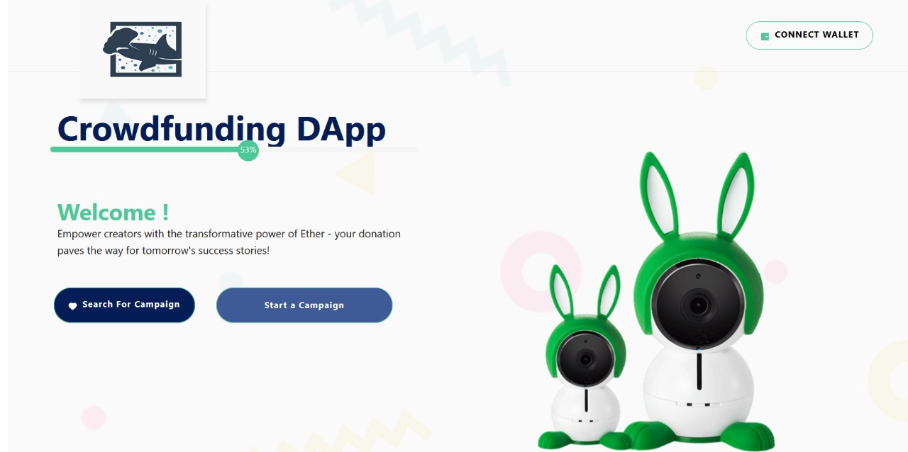
Implementation

Slide 11
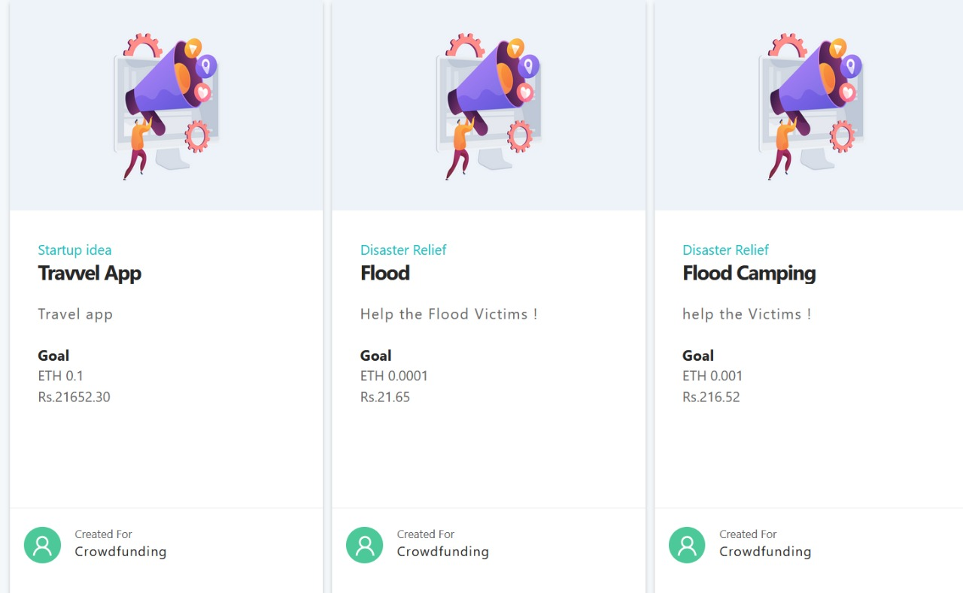

Slide 12
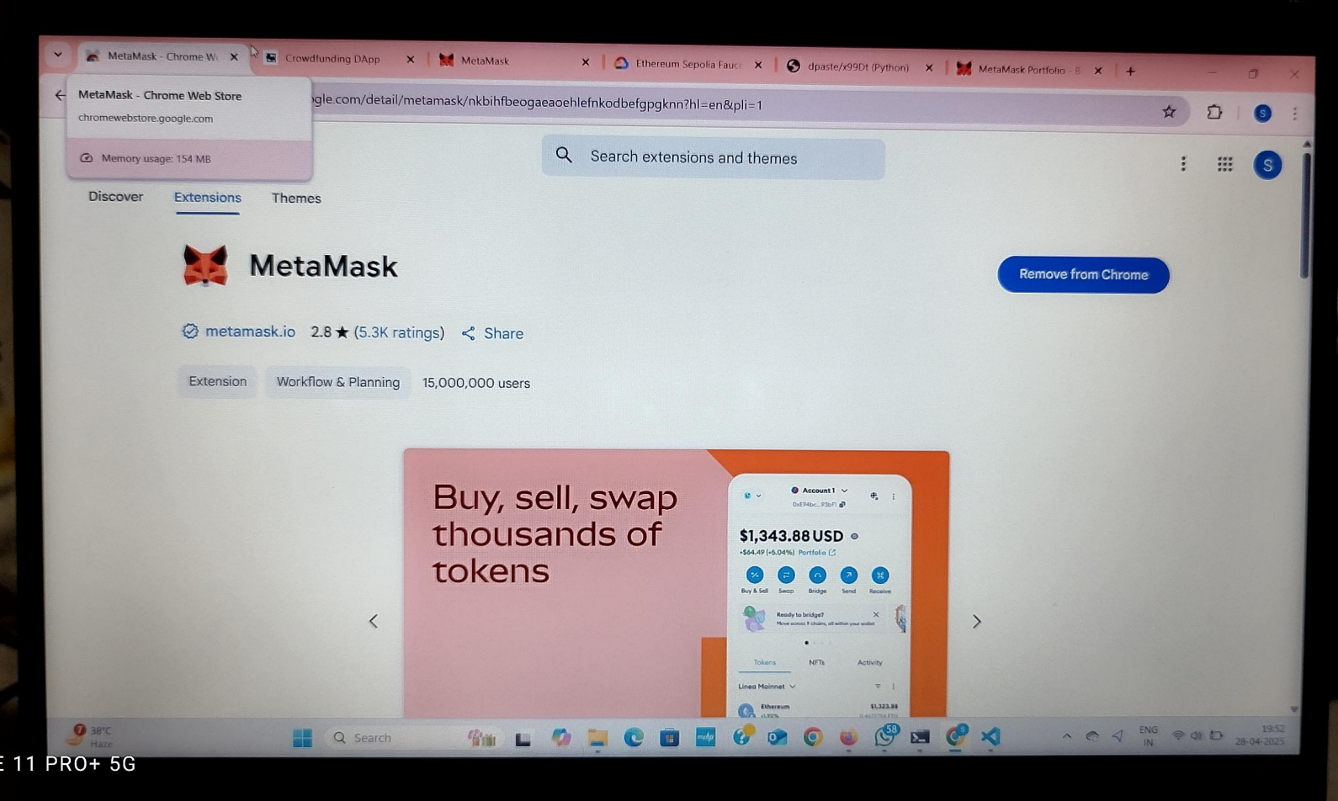
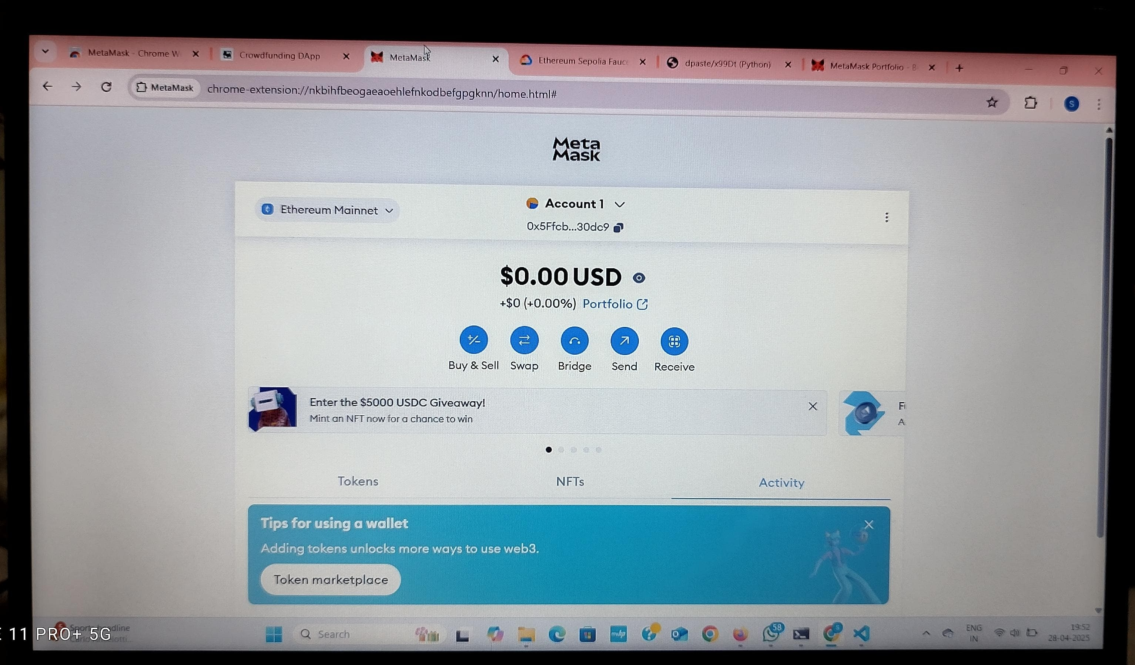
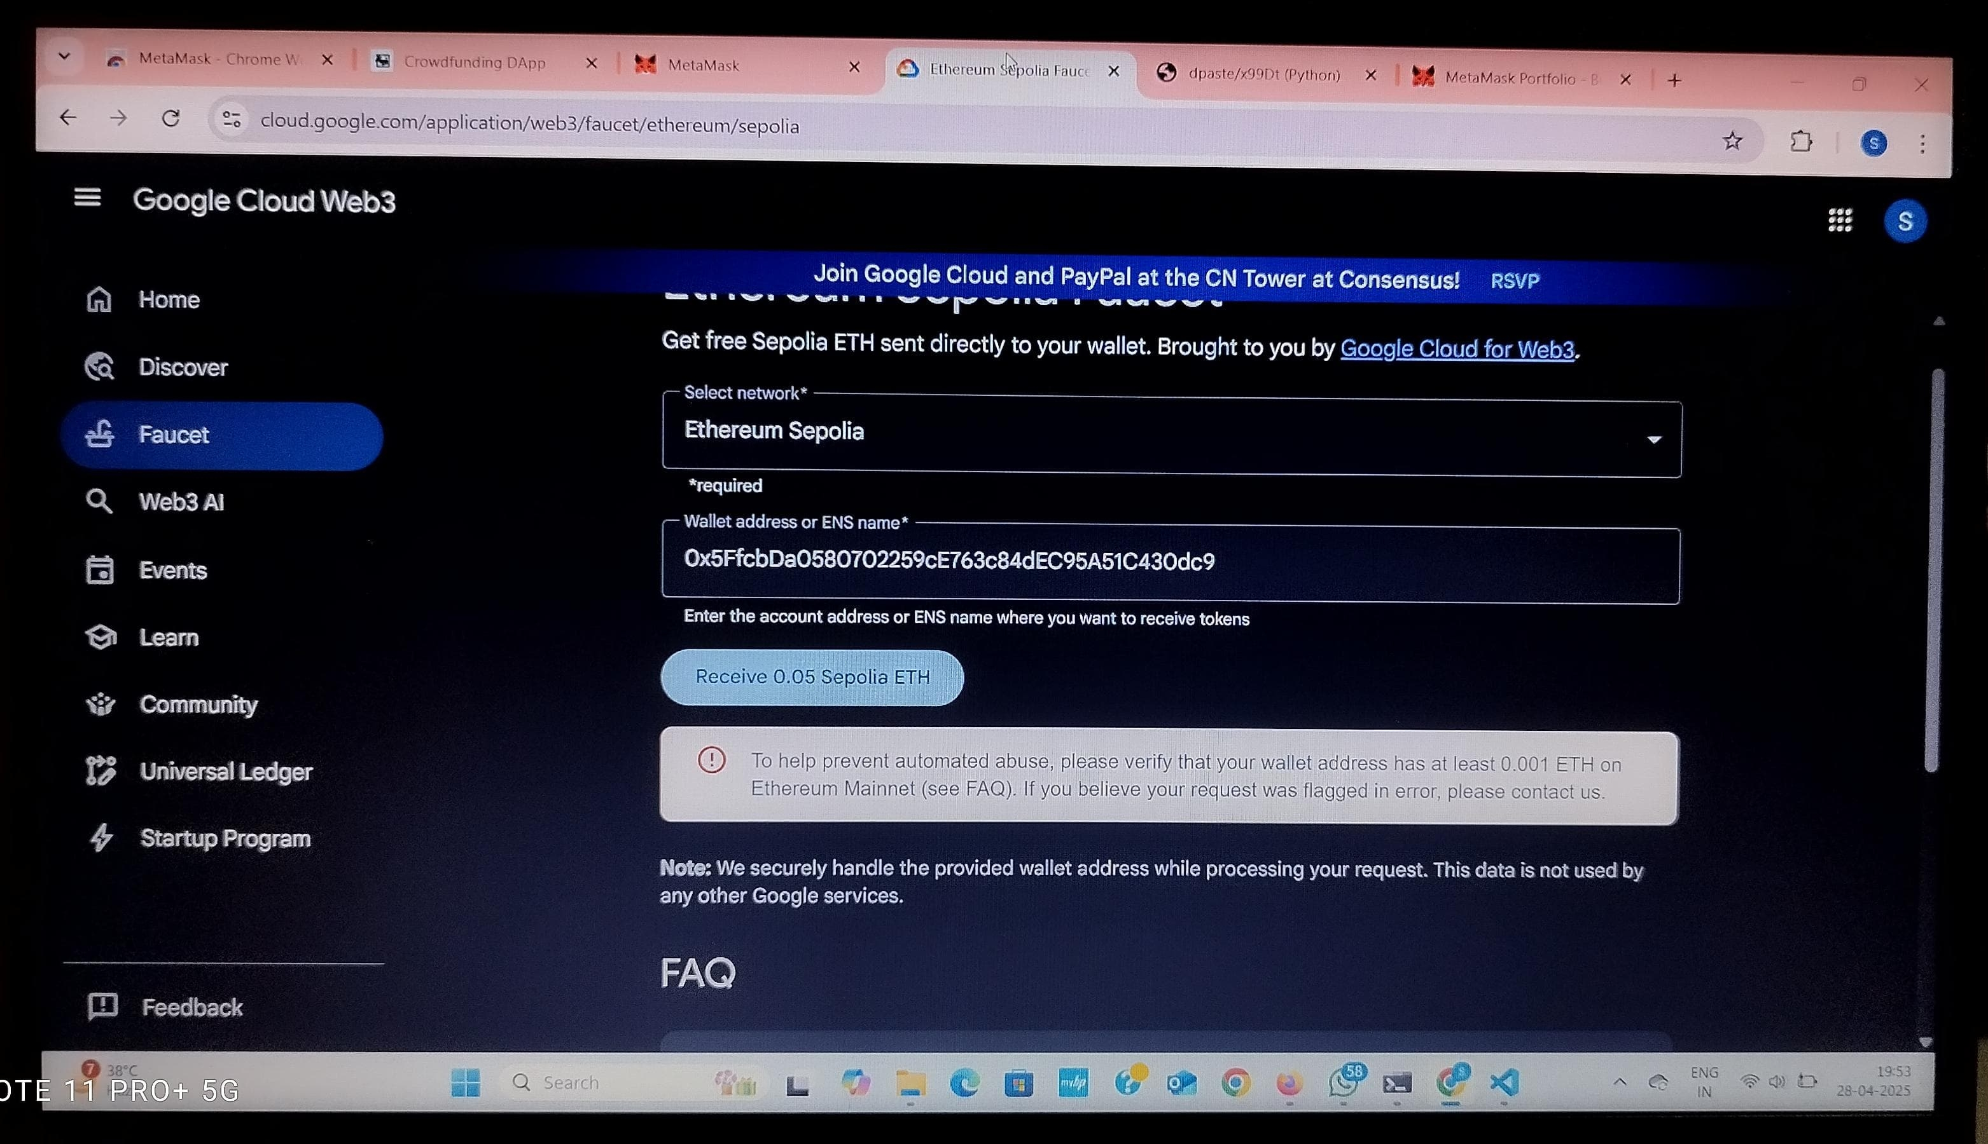

Slide 13
Conclusion
The first phase establishes a functional frontend with React.js/Next.js, wallet integration, campaign creation and real-time campaign tracking, laying the foundation for a decentralized crowdfunding system..

